Slide 1
Test -1
Based on
Generating Test Cases From Use Cases by Jim Heumann, Requirements Management Evangelist Rational Software

Slide 2
How do discover errors…
Not by accident when the program is being used
But in a systematic and effective way

Slide 3
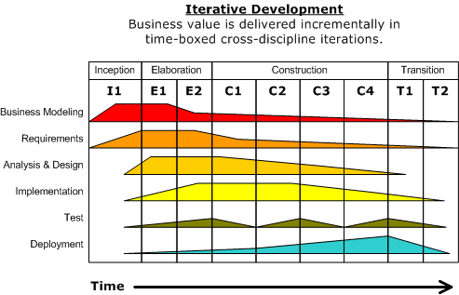
Test as discipline in UP
Test throughout the development process
Continuously verify quality

Slide 4
Test cases
A test case is a set of test inputs, execution conditions, and expected results developed for a particular objective, e.g.:
Verify compliance with a specific requirement
To exercise program parts: methods, etc.
The purpose of a test case is to identify and communicate conditions that will be implemented in test.

Slide 5
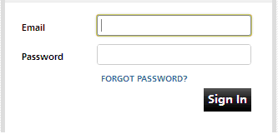
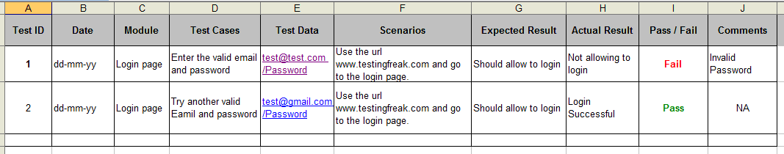
Example test cases for validation of email field on login page
Source: http://testingfreak.com/test-case/

Slide 6
Test cases generation at system level
The most important part of a use case for generating test cases is the flow of events.
The two main parts of the flow of events are the basic flow of events (happy days scenario) and the alternate flows of events.
The alternate flows of events covers
Variations of the normal behavior
Optional behavior
Exceptional behavior (relative to the normal behavior)

Slide 7
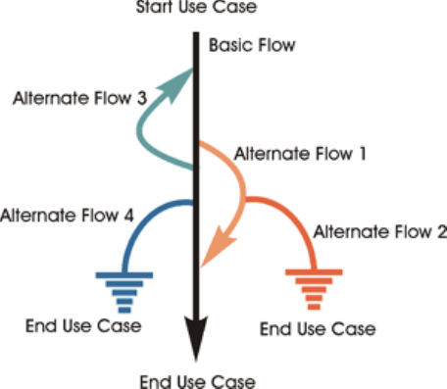
Scenario (Use case scenario)
A scenario is an instance of a use case, or a complete "path" through the use case.
E.g.
Scenario 1: Basic Flow
Scenario 2: Basic Flow, Alternate Flow 1
Scenario 3: Basic Flow, Alternate Flow 1, Alternate Flow 2

Slide 8
Generating test cases from use cases
Process for generating test cases from a fully detailed use case:
For each use case, generate a full set of scenarios.
For each scenario, identify at least one test case and the conditions that will make it "execute."
For each test case, identify the data values with which to test.

Slide 9
Fremgangsmåde systemtest
Grundlag (Baseret på fully-dressed use case)
Fastlæg happy day og alternative flows (all flow of events)
Opstil scenarie for hvert flow
Opstil mindst 1 test case for hvert scenarie – samt hvad der får scenariet til at ske
Tilføj data værdier til hver test case
Hvorfor bruge en fremgangsmåde?

Slide 10
Exercise
Test cases for system test
Modul 2 Exercise_Test-cases-for-system-test

